Slide 1
Atmosphere to Electrons (A2e)
Aeroacoustics and Propagation
DOE Wind and Water Power Technologies Office
Patrick Moriarty
February 2014

Slide 2

Overview
Why is aeroacoustics a thrust area?
Noise is an impediment to wind energy construction
Issue will grow as penetration levels increase
No common understanding of what’s annoying
Potential reductions in cost of energy
Noise reduced operation is lost energy
Some studies show increased tip speeds (i.e. noise) reduce turbine cost

Slide 3
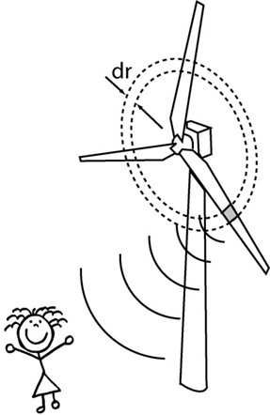
Correlation with A2e objectives
Optimized Performance of Existing Wind Plants
LCOE Reduction
Seamless Grid Integration at High Penetration
Reduce annual curtailment
Next Generation Wind Plant Technology Development
Reduced acoustic emissions 6 dB relative to 105 dB baseline

Slide 4
Approach for Strategy Development
Initial strategy document – November 2013
Disseminated to experts and gathered initial feedback
Experts Meeting
January 20-21, 2014 in Arlington, VA – day and half
~30 attendees (90 invitees)
Breakout groups
Turbine Technology
Wind Plant Layout and Operation
Community Impact
Summary report by March
A2e Merit Review – February 2014
Planning group – subset of 6 experts
Take expert meeting summary as input
5-7 year plan to DOE by June

Slide 5
Key Contributors to Date
Name | Organization | Industry Role
Pat Moriarty (Lead) | NREL | National Lab
David Maniaci | Sandia | National Lab
Matt Barone | Sandia | National Lab
Shreyas Ananthan | DOE WWPTO | DOE
William Devenport | Virginia Tech | Academic R&D
Kevin Kinzie | GE Wind | OEM
Mark Bastasch | CH2MHill | Acoustic Consultant

Slide 6
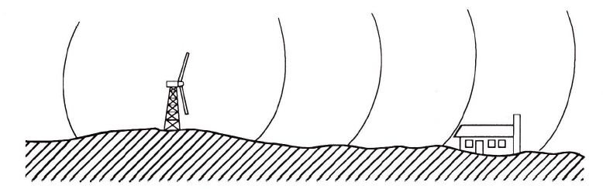
Thrust Focus Areas
Turbine Technology
Prediction and measurement of source
Turbine design and control strategies
Wind Plant Layout and Operation
Propagation
Layout and operation
Community Impact
Information vetting
Public perception – what’s annoying?
Measurement standards

Slide 7
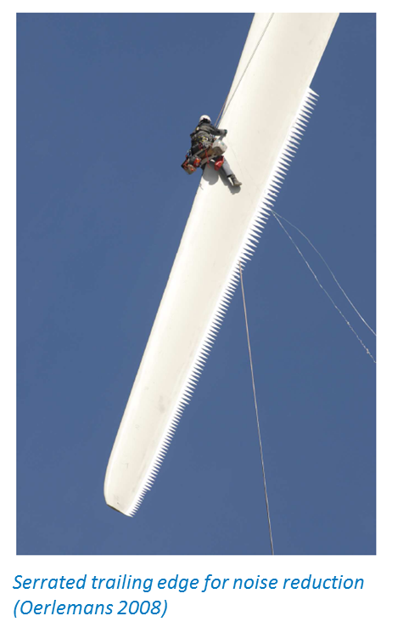
Current State of the Art
Turbine Technology
Semi-empirical 2D noise models
Wind tunnel testing common
Serrations
2-4% loss in AEP per 1 dB reduction
Wind Plant Layout and Operation
Layout constraint on noise
Simple propagation models – ISO 9613
No interaction with…
Terrain and vegetation
Atmosphere
Between turbines
Community Impact
Varying community regulations
Mis/disinformation prevalent
No standard measurement or modeling practices
Amplitude modulation thought to be most annoying

Slide 8
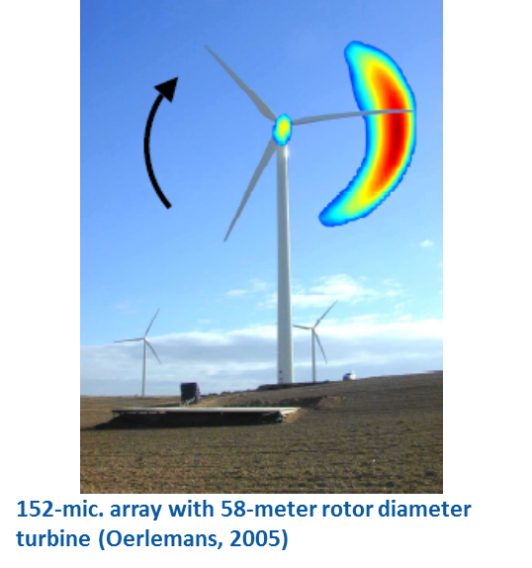
Key Research Challenges and Technical Barriers
Turbine Technology
Reduce noise at same power or
Increase power with same noise
Unsteady noise production
Scaling
Noise control
Wind Plant Layout and Operation
Accurate and validated noise propagation models
Terrain, vegetation and atmosphere
Amplitude modulation physics
How does turbine noise change within wind plants?
Building/structural response
Community Impact
Complaints from projects that meet regulation
Determination of relevant metrics
Extreme events may dominate instead of constant dB level
Mis/disinformation
Guidelines for regulation, modeling and measurement

Slide 9
Approach
Technology Transfer
Open source freely available datasets and simulation tools
Open source geometries and control if possible
IEA Task on Wind Plant Noise
Turbine Technology Goal
-6 dB at constant power by 2020 relative to 105 dBA fleet average
Testing
Airfoils, turbines and wind plants
Wind tunnel
Unsteady airfoil testing
Sub and full scale
Details of multiple turbines and inflow
Range of operating and atmospheric conditions
Topography
Background noise

Slide 10
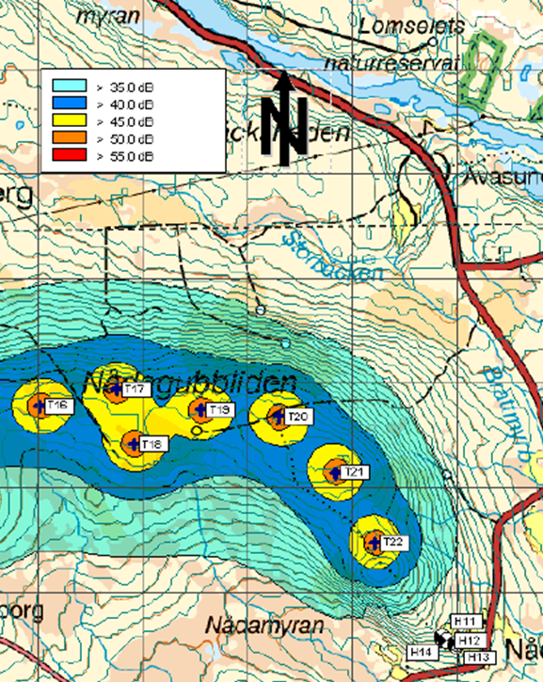
Approach (cont.)
Propagation Studies
Partnerships – NOAA, DoT, DoD, NASA
Leverage previous research
Range of atmospheric conditions
Buildings/Structures
Amplitude Modulation
Fundamental understanding of creation and propagation
Simulation Tools
Turbines and wind plants including propagation
Physically appropriate – time and spatially dependent
Range of fidelity and quantify uncertainty bounds
Periodic validation comparison exercises
Active and passive turbine and wind plant control

Slide 11

Approach (cont.)
Human Response
Partnerships - NASA and NIH
Relevant metrics for wind turbine noise
Probabilistic vs. deterministic
Extremes vs. steady operation
Infrasound detection
Sleep studies
Indoor/Outdoor sound transmission
Dose response
Public Dissemination
Website with continually updated information on wind turbine noise
Comparison between 1980’s and now
Review regulatory history for other sources
Guidelines and best practices
Modeling and measurements
Review and update standards

Slide 12
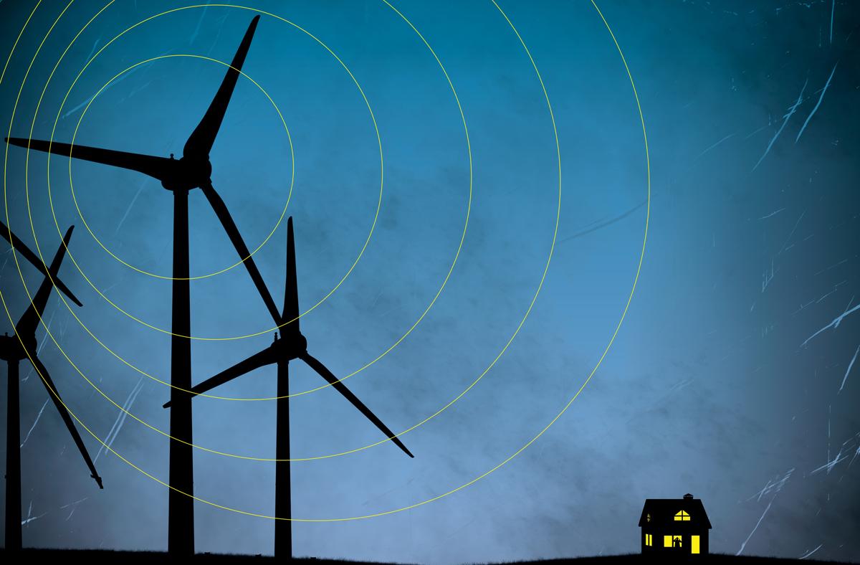
Accomplishment Expectations
Scientific understanding of annoyance and appropriate metrics
Independent objective summaries to inform wider community
Standards for wind turbine noise measurement and simulation
Propagation models for siting that include atmosphere, topography, and turbine interactions
Validated simulation tools with quantified uncertainty bounds
Tools and data for wind plant noise mitigation and control

Slide 13
Timeline
Human Response
Studies
Propagation Model
Release
HFM Turbine
Model Release
Begin IEA
Task
Full scale wind
plant test
Wind tunnel
airfoil testing
Engineering Simulation
Tools Released
2015
2016
2017
2018
2019
2020
Model Validation
Exercise
Model Validation
Exercise
Website for public
dissemination with
myths and facts
State of the art
summaries
Wind Plant Control
Studies
Measurement and
modeling
guidelines

Slide 14

Summary
DOE Program to Address Noise Issues:
Combination of engineering and human response research
Multiyear program of observations and modeling
First priorities
Information dissemination
Propagation
Human response
Amplitude modulation
Leverage outside expertise
Focus Questions for the Merit Panel:
Proposed activities relevant?
Highest priorities correct?
Appropriate line between industry and DOE activities?

Slide 15

Questions?

